Slide 1

Predicting the Best western SUBURBs IN Melbourne, Australia to open a new Franchise for an Indian restaurant
Capstone Project – Final Presentation
Pradeep Reddy N

Slide 2
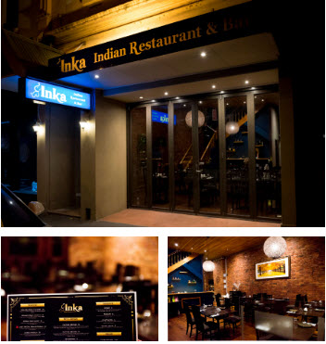
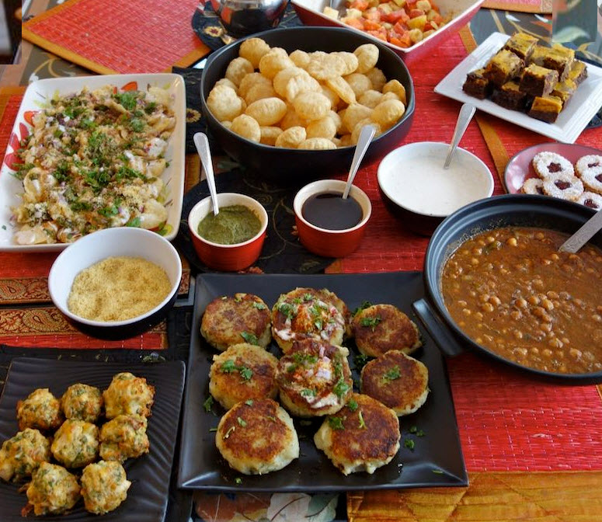
INKA RESTAURANT ANALYSIS

Slide 3
Introduction
Background
As part of the IBM Data Science professional program project, I have reached out to one of my close acquaintance who is the restaurant owner of INKA Australia Inkarestaurant Australia and will be doing analysis on the best western suburbs in Melbourne, Australia chosen by the management to expand their business. This is a real time example for which I will be performing analysis and advising the management as to which would be the best suburb from the 3 councils (Hobsons Bay, Brimbank, Wyndham).
Business Problem
Since expanding their restaurant business to other suburbs would be a cost and risk-based plan for the management, they have selected 3 councils i.e, Hobsons Bay, Brimbank and Wyndham but again there is challenge for them to select out of 60 suburbs as to which would be the best suburb for the setup.
We will analyse the localities in the western suburbs in Melbourne to identify the most profitable suburb since the success of the restaurant depends on the nearby venues and categories.
I will go through all the process and will provide a conclusion whether the analysis can be leveraged by the business stakeholders to make their decisions.
Interest
Restaurant management who are considering to expand their business to Western suburbs of Melbourne. Chose mainly 3 councils where they are interested to setup the restaurant.

Slide 4
2. Data Requirements and Cleaning
Data Sources
First data sources of the project will be used from the site https://www.matthewproctor.com/full_australian_postcodes_vic as it has all the relevant information for the project. Geo-locational information (latitude and longitude) about that specific locality and the suburbs is also included.
Second data sources for the Suburbs Population, household income was extracted from the https://itt.abs.gov.au/ to an excel file and filtered out based on the 3 suburbs
Data Cleaning
From the excel file which was extracted from the first source , we will be filtering out the data based on the 3 chosen councils
Missing value imputation on the first source will be performed
The data sets will be grouped to find out the venues in the localities
From the second sources will be filter out the data based on the population, Household income, Suburb(Locality) and create a compounded bar chart
The new data set is used to generate the 10 most common venues for each locality using the foursquare API, finally using means clustering algorithm to cluster the similar localities together

Slide 5
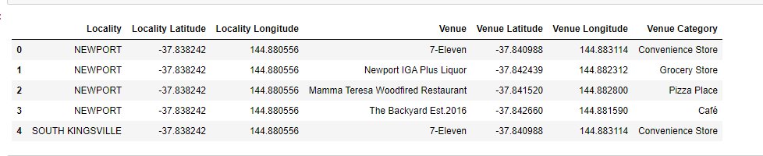
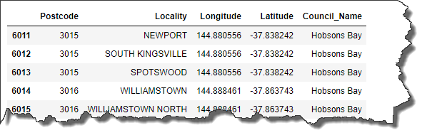
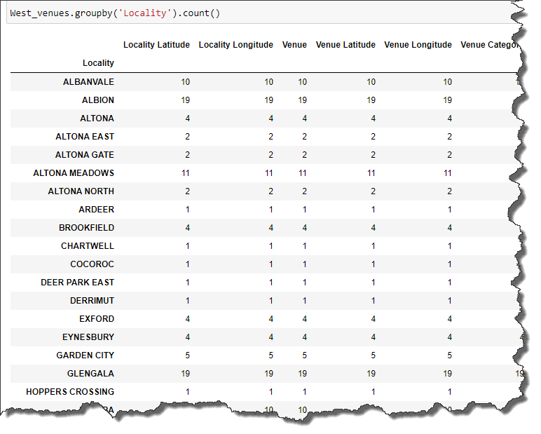
3. Methodology
Exploratory Data Analysis
Filtering the data and missing value imputation
Rename the column names to identify the council names
Grouping the data based on the locality

Slide 6
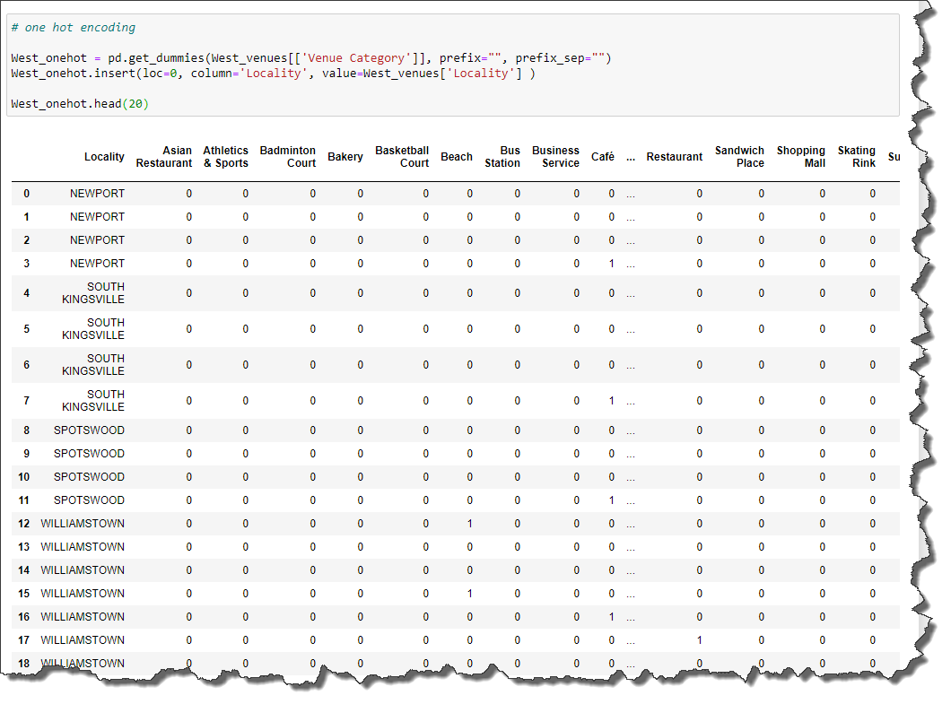
3. Methodology
Modelling
Using the final dataset containing the localities in 3 western suburbs in Melbourne along with the latitude and longitude, we can find all the venues within a 500-meter radius of each locality by connecting to the Foursquare API
One hot encoding is done on the venues data. (One hot encoding is a process by which categorical variables are converted into a form that could be provided to ML algorithms to do a better job in prediction). The Venues data is then grouped by the locality and the mean of the venues are calculated, finally the 10 common venues are calculated for each of the locality.
To help people find similar locality in the safest borough we will be clustering similar locality using K - means clustering which is a form of unsupervised machine learning algorithm that clusters data based on predefined cluster size. We will use a cluster size of 5 for this project that will cluster the 3 localities into 5 clusters. The reason to conduct a K- means clustering is to cluster locality with similar venues together so that people can

Slide 7
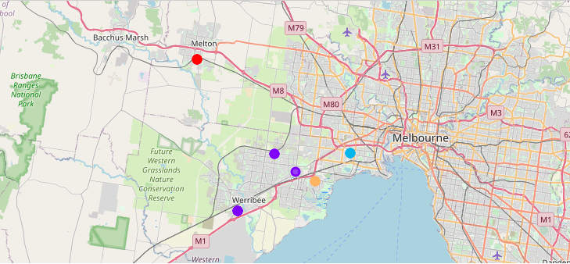
4. Results
After running the K-means clustering we can access each cluster created to see which locality was assigned to each of the five clusters. Visualizing the clustered neighbourhoods on a map using the folium library
Each cluster is color coded for the ease of preparation, we can see that majority of the locality falls in the purple cluster which is second cluster. 3 localities have their own cluster ( Red, blue and Orange)

Slide 8
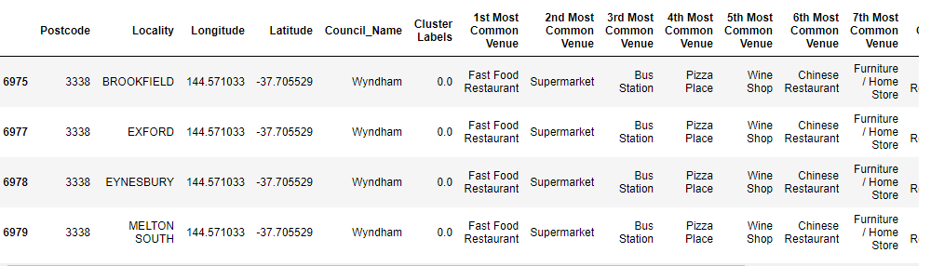
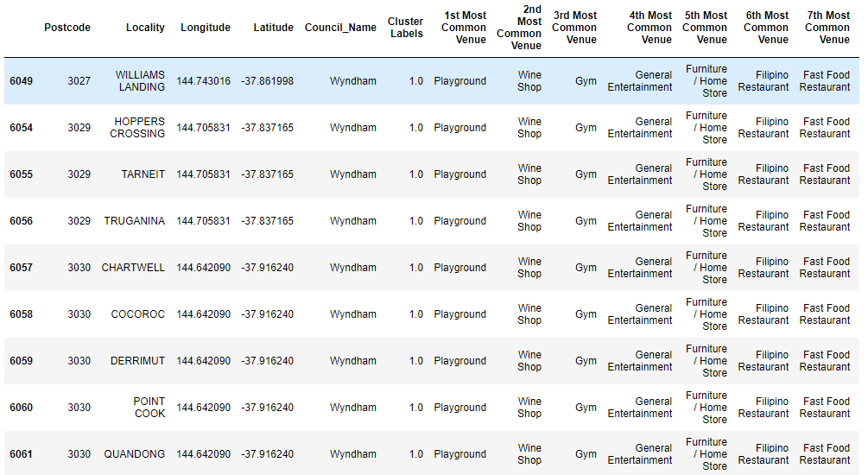
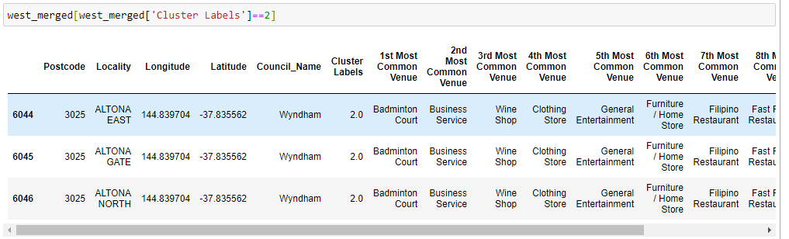
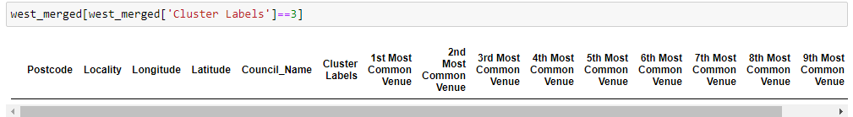
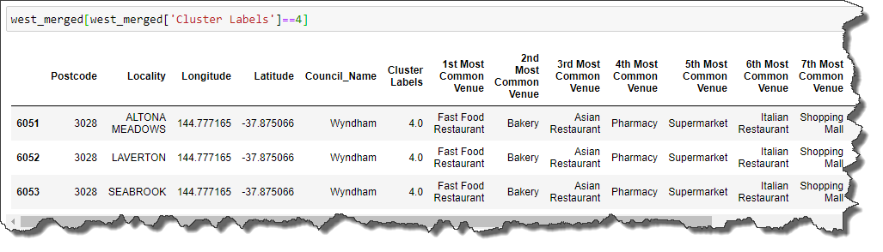
4. Results
Cluster 1:
Cluster 2:
Cluster 3:
Cluster 4:
Cluster 5:

Slide 9
5. Discussion
The aim of this project is to help the restaurant management to make a decision to setup a location choosing the best council and locality based on the venues, categories, population, household income.
Based on the data Cluster 4 are more suitable due to the common venues in that cluster, these localities to have common venues such as Parks, Gym/Fitness centres, Bus Stops, Restaurants, Electronics Stores and Soccer fields which is ideal for a to setup a restaurant so that the foot traffic can be increased and can be more profitable.

Slide 10
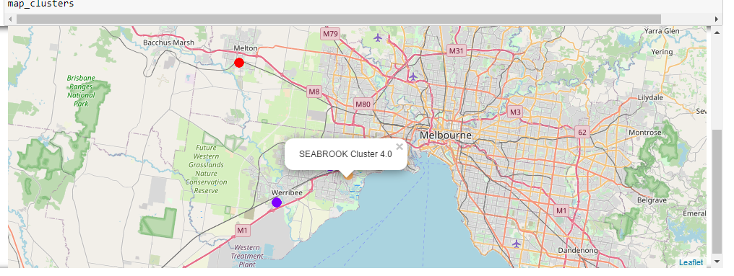
6. Conclusion
This project gives a high-level documentation for the restaurant management team to get a better understanding of the localities under 3 councils with respect to the most common venues, population and household income in those localities.
It is always helpful to make use of technology to stay one step ahead i.e. finding out more about places before setting up a restaurant in a particular area. The ultimate investment and decision of this project would require consideration of other factors such as cost of living in the suburbs, ethnicity, median house prices which would give more in depth analysis.

